Slide 1
Cloud Computing With Azure
Course: AZ-900 Azure Fundamentals

Slide 2
Day 1: Agenda
Scenario before cloud computing
What is cloud computing?
Scenario after cloud computing
One real time example
Example of cloud computing
Types of cloud computing( service and deployment model)
Capex & Opex
What is Microsoft azure?
Microsoft azure services
Steps for creating a Azure Account
Ways of accessing Microsoft Azure
Azure Subscriptions
Azure resource groups
Azure subscriptions and resources
Companies who use Azure

Slide 3
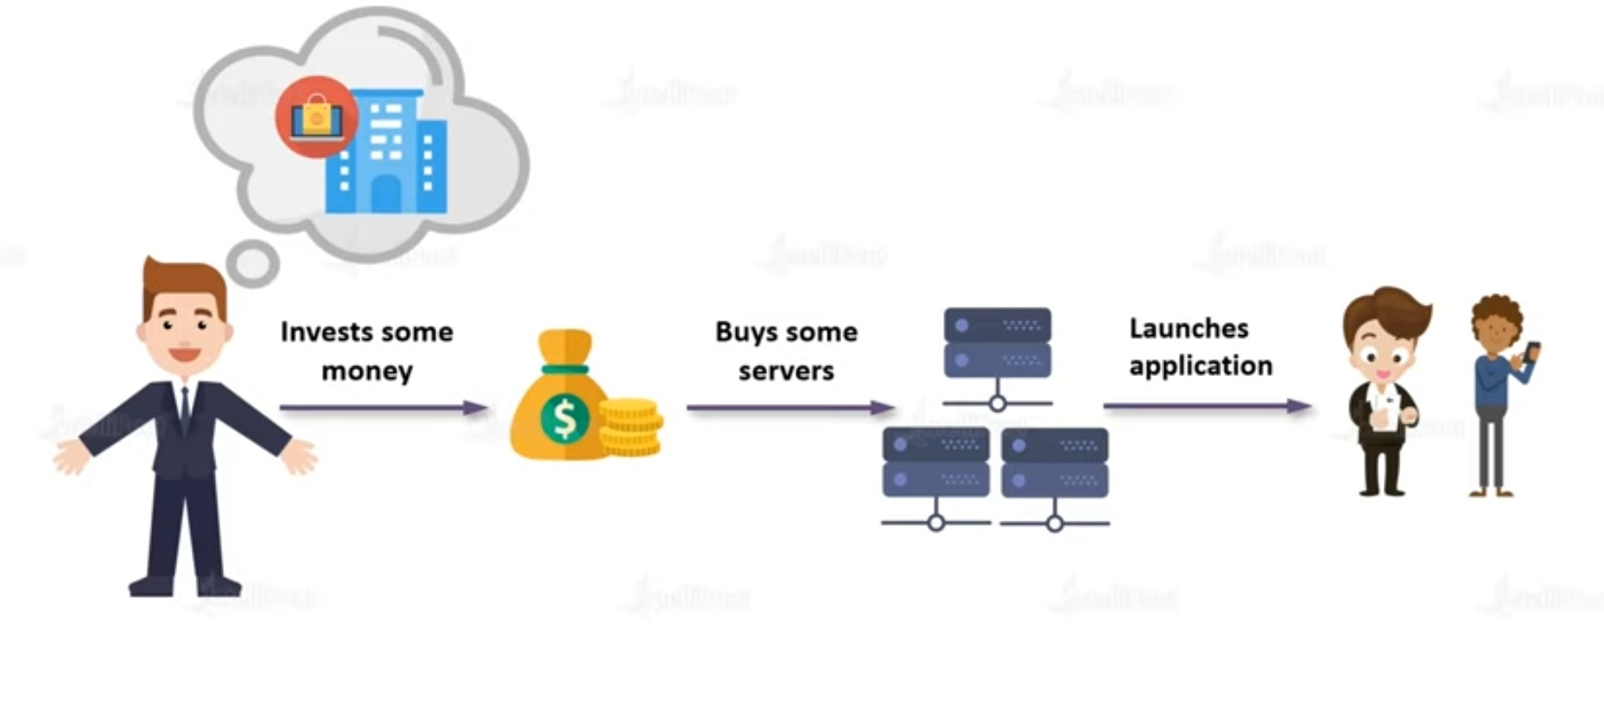
Before Cloud Computing

Slide 4
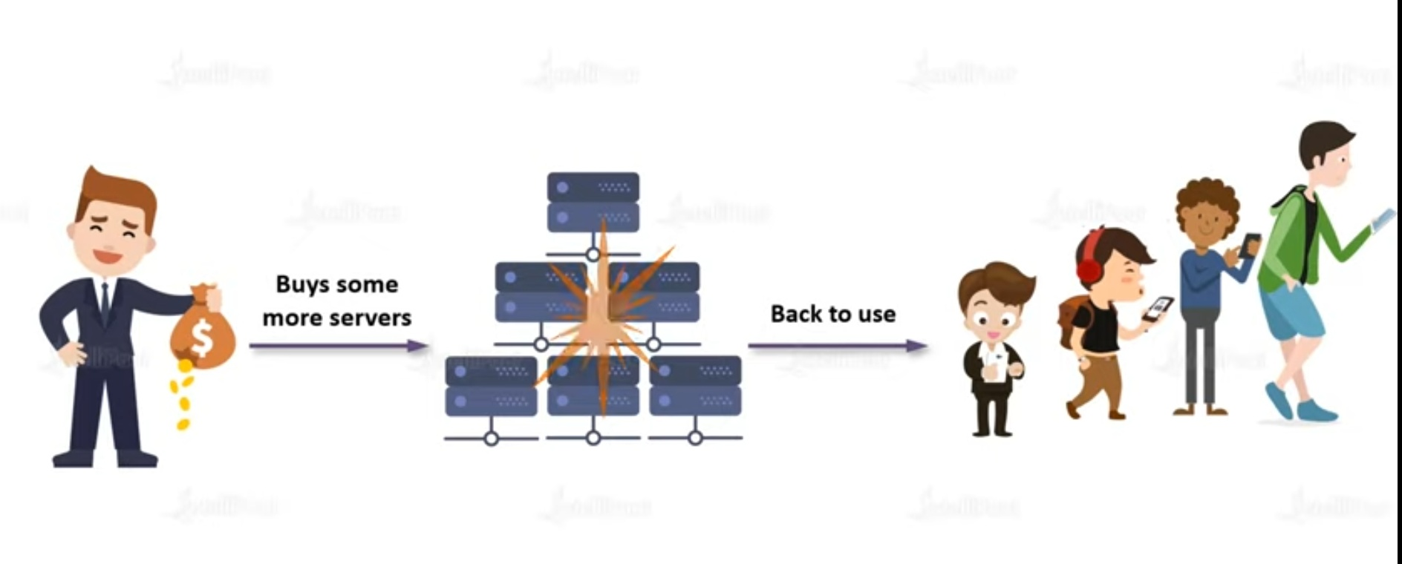

Slide 5
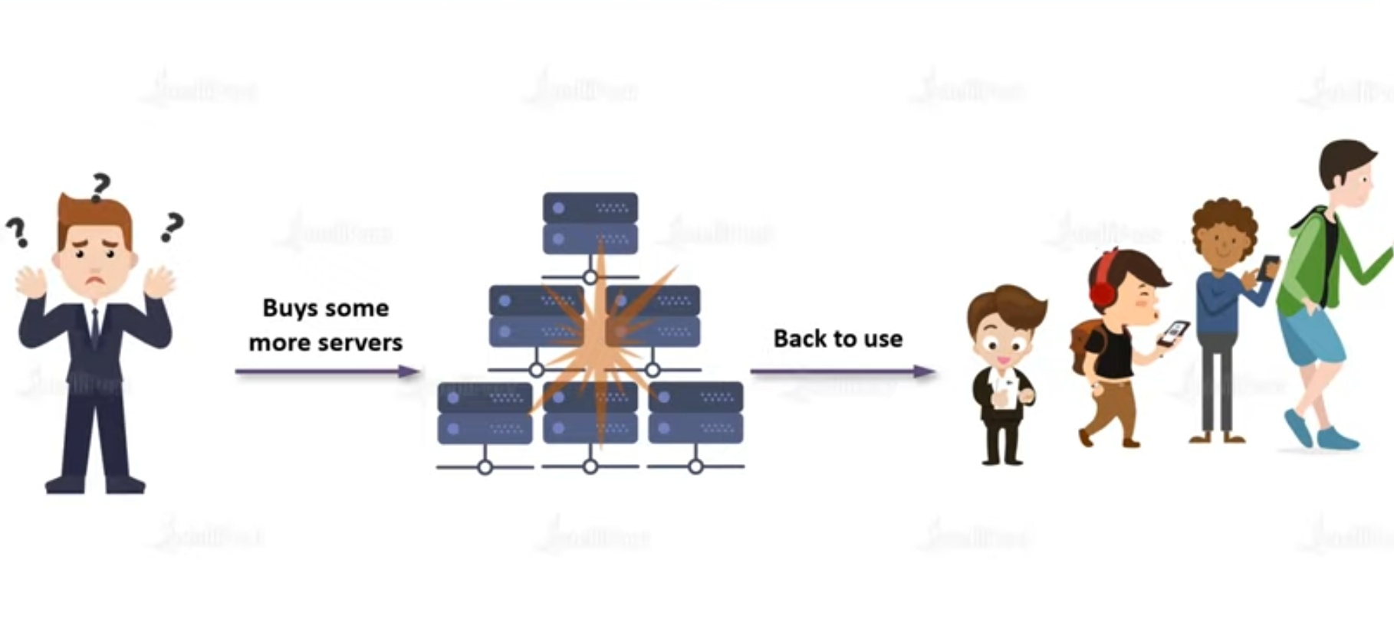

Slide 6
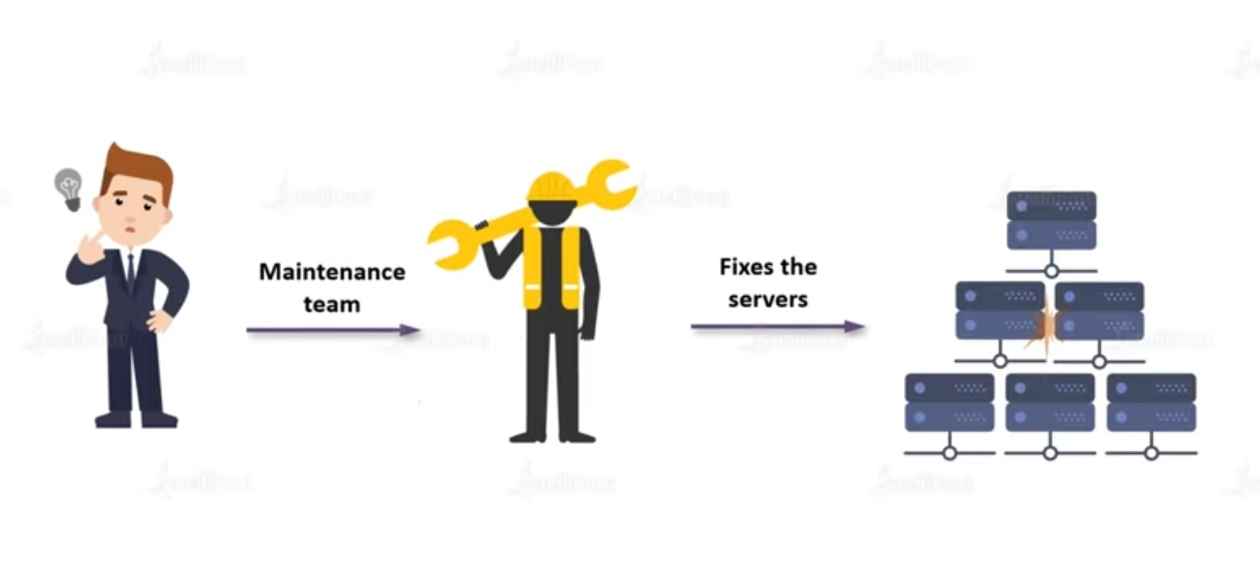

Slide 7
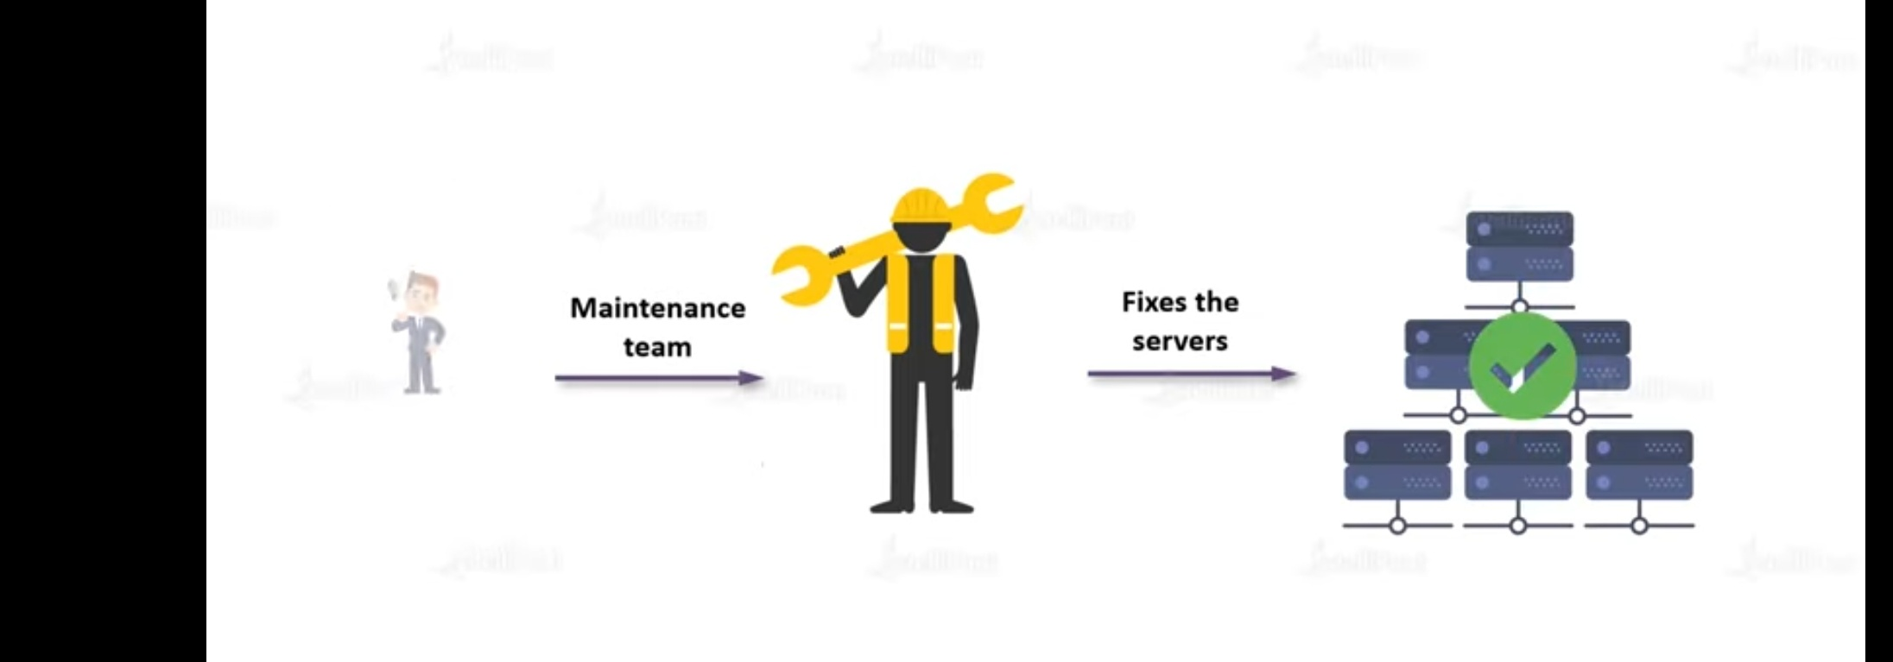

Slide 8
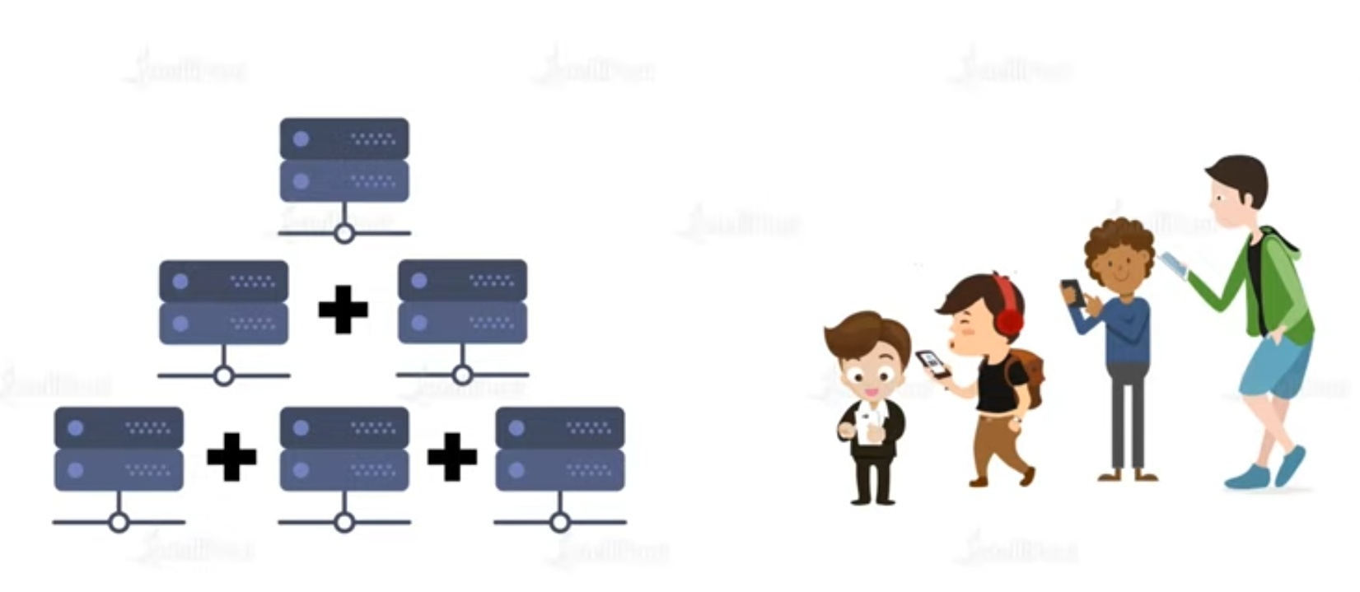

Slide 9
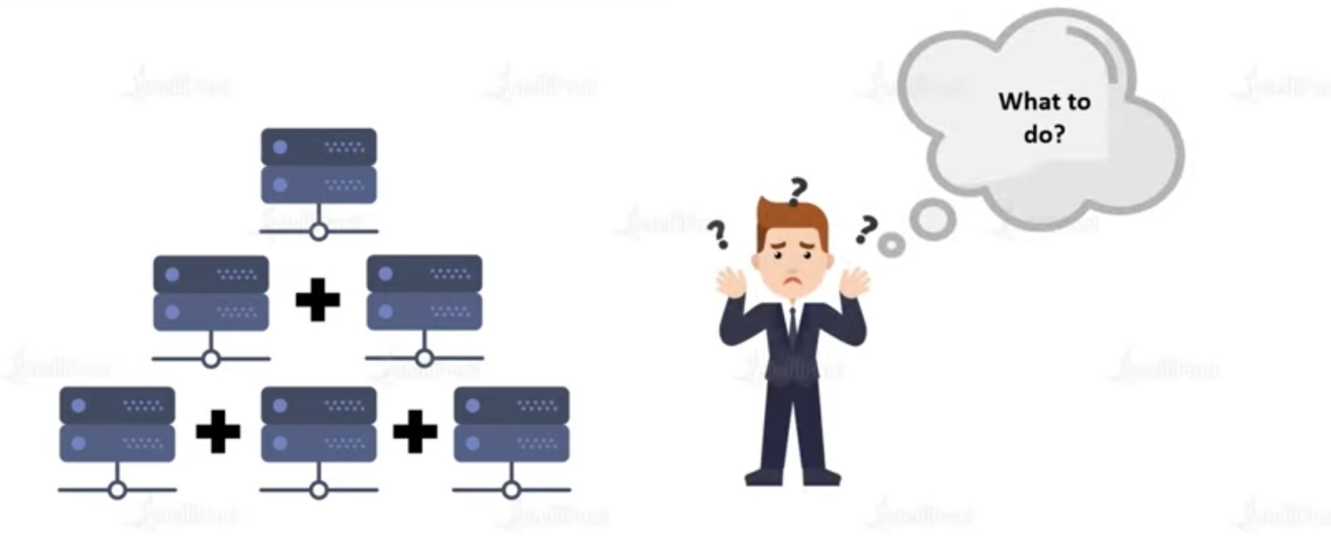

Slide 10
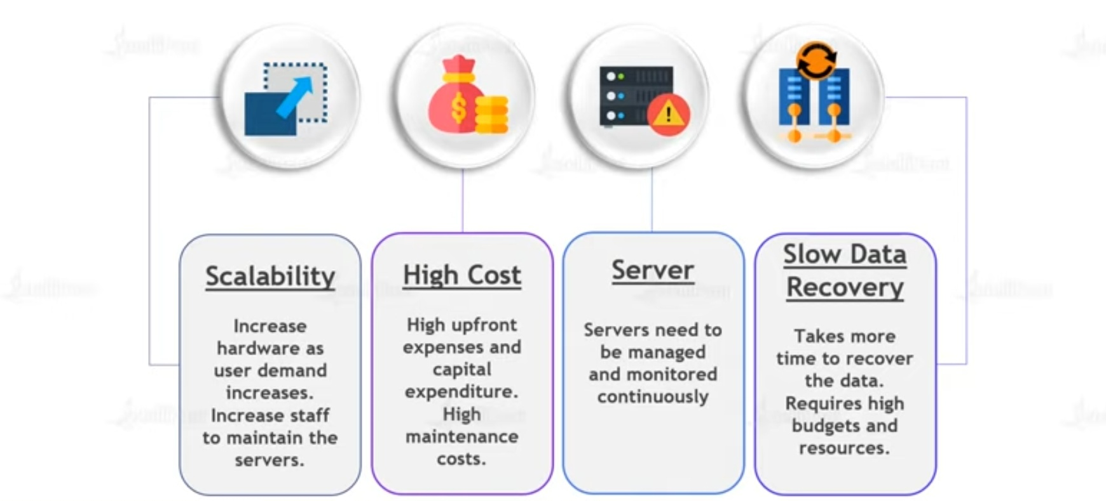

Slide 11
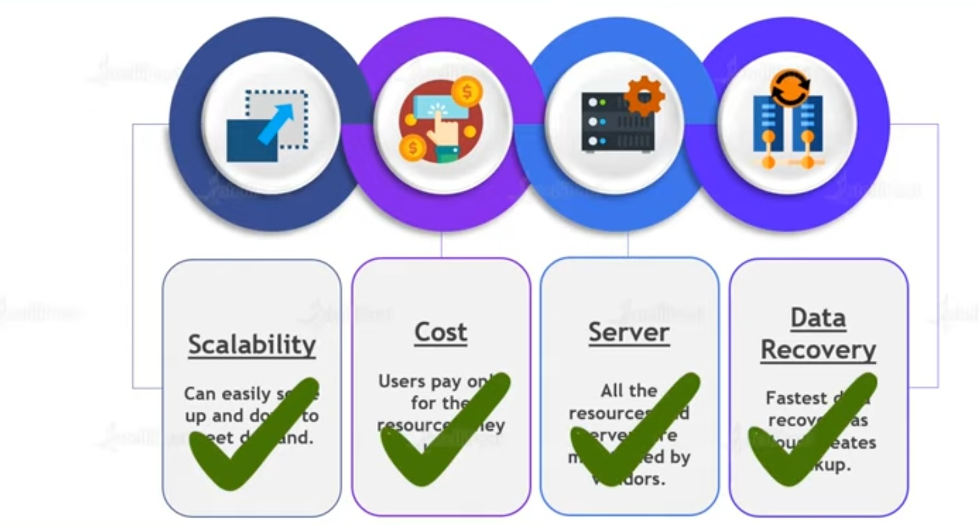
Scenario after cloud computing

Slide 12
What is cloud computing
"Cloud is about how you do computing, not where you do computing," goes a popular refrain in the domain of modern computing.
Cloud computing is the delivery of computing services like servers,storage,databases,networking,software,analytics, intelligence and more over the internet to offer faster innovation,flexible resources and economies of scale.
CC is basically accessing and using various computing services and resources via the internet

Slide 13
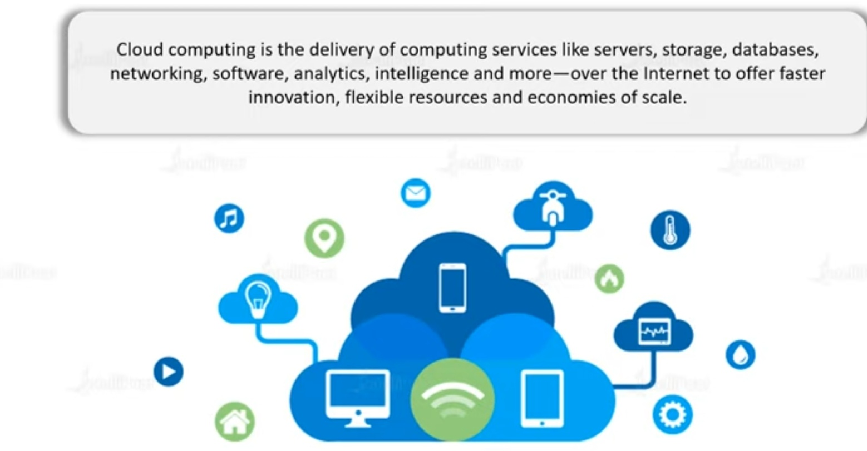

Slide 14
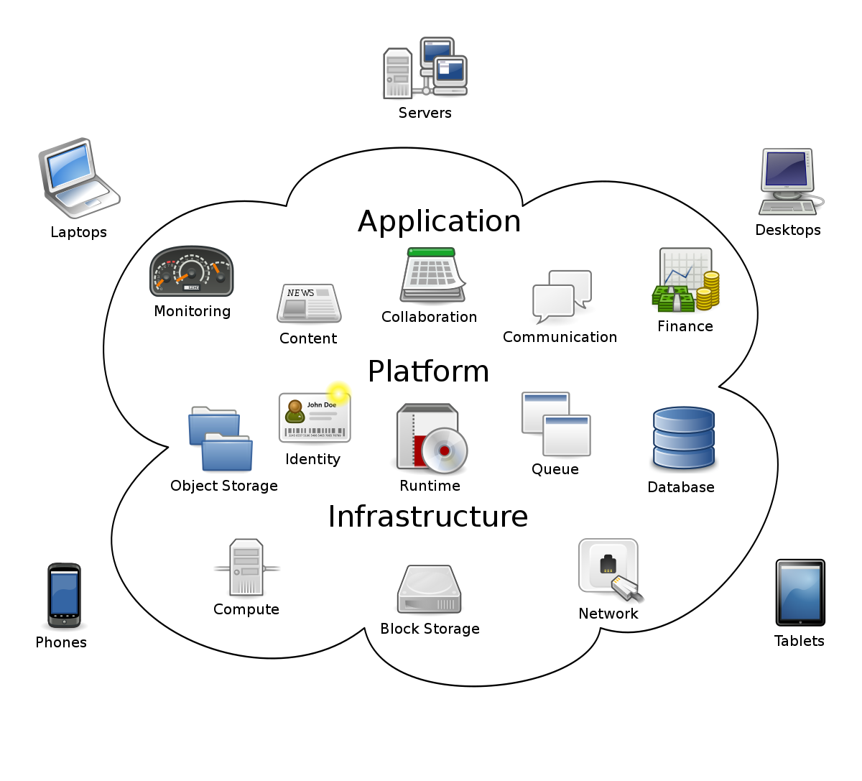

Slide 15


Slide 16
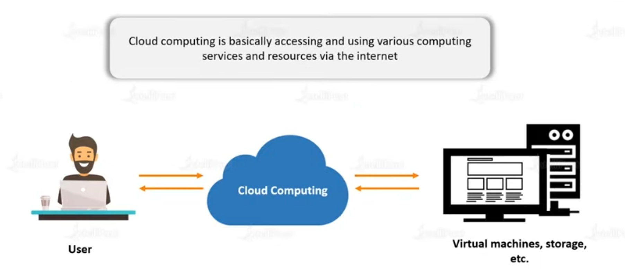

Slide 17
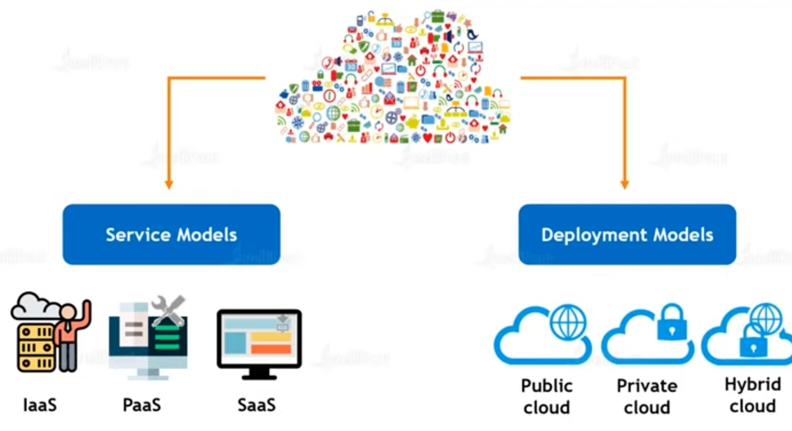
Types of cloud computing

Slide 18
1: Service model
IaaS
SaaS
PaaS

Slide 19
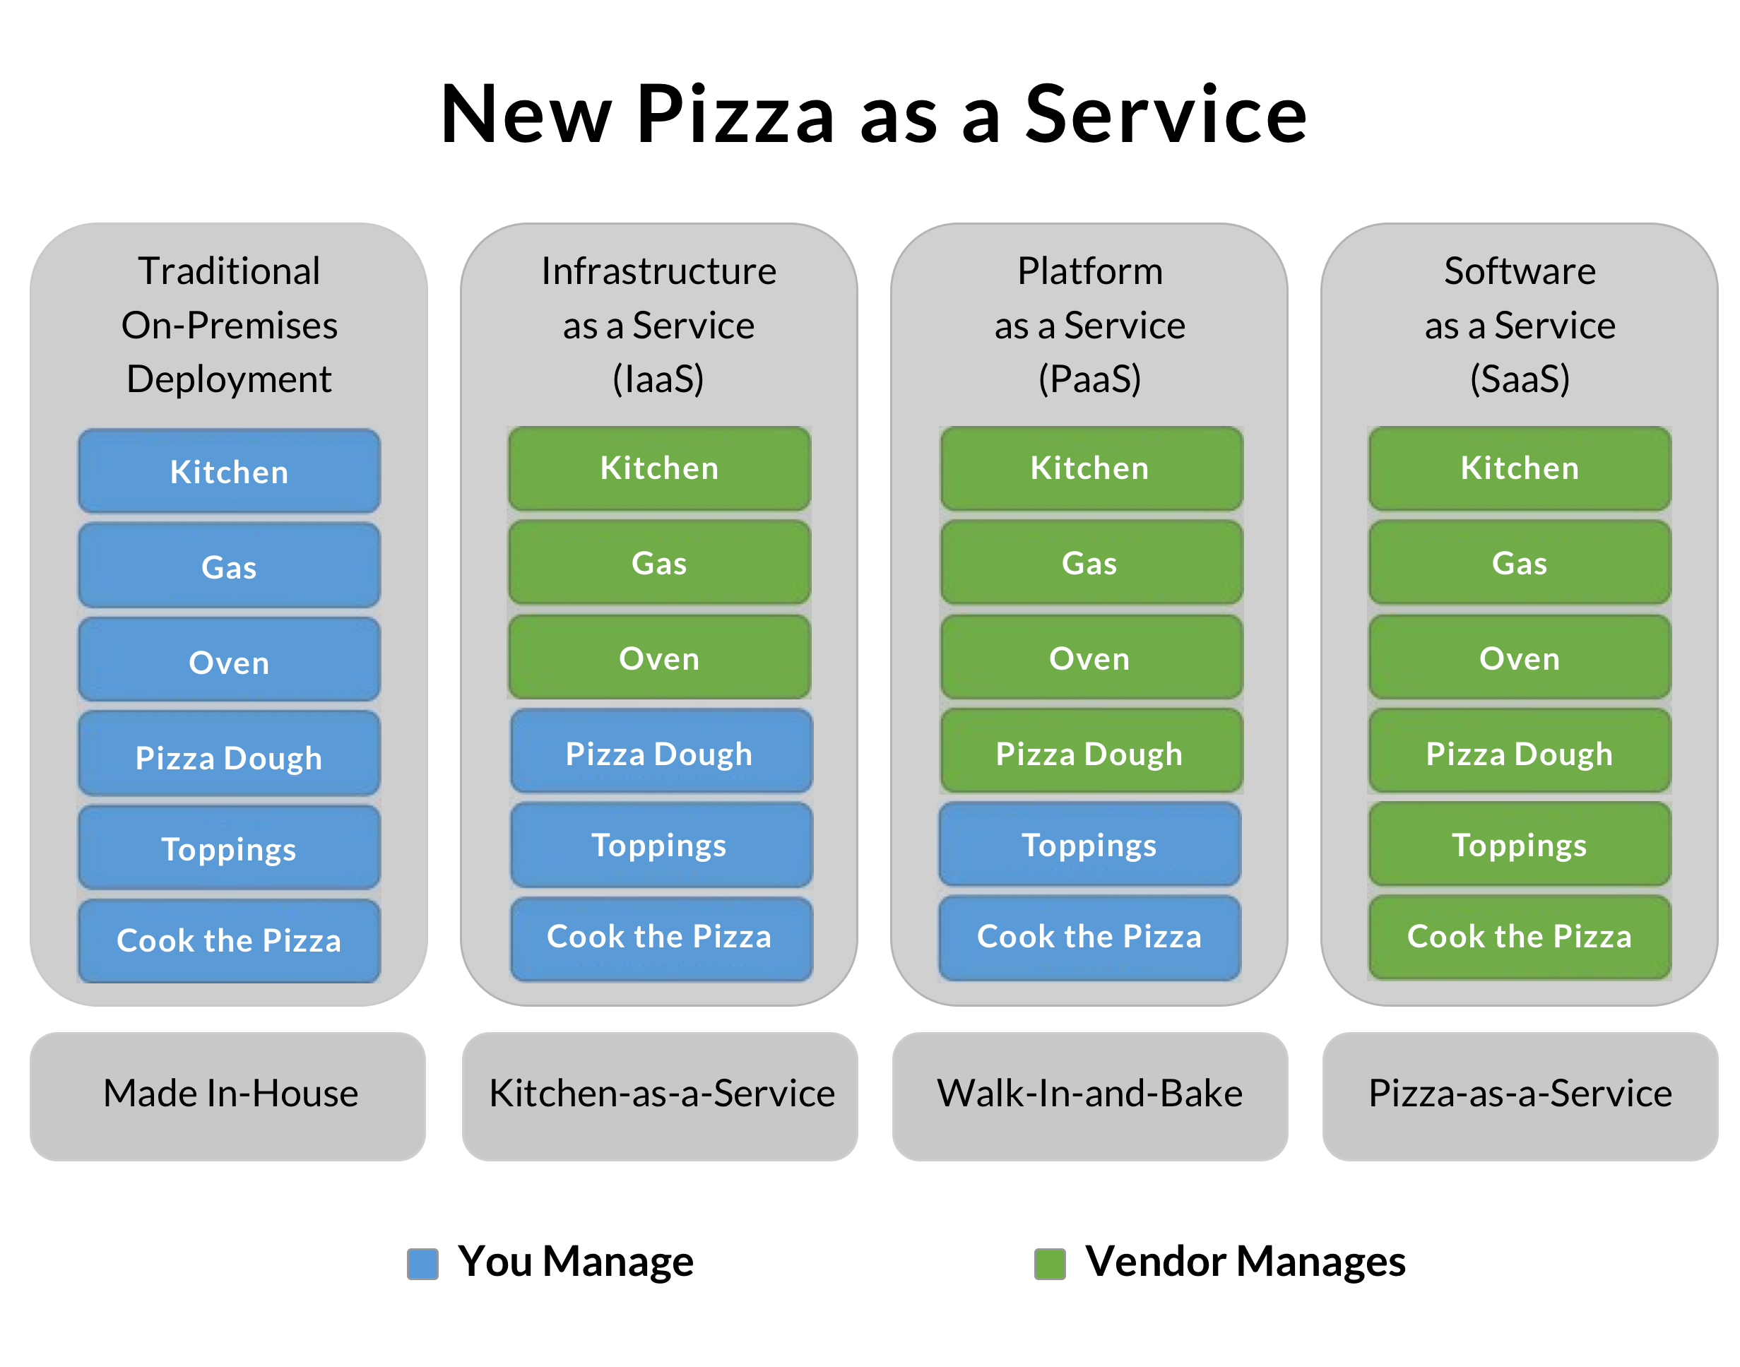
Example:

Slide 20
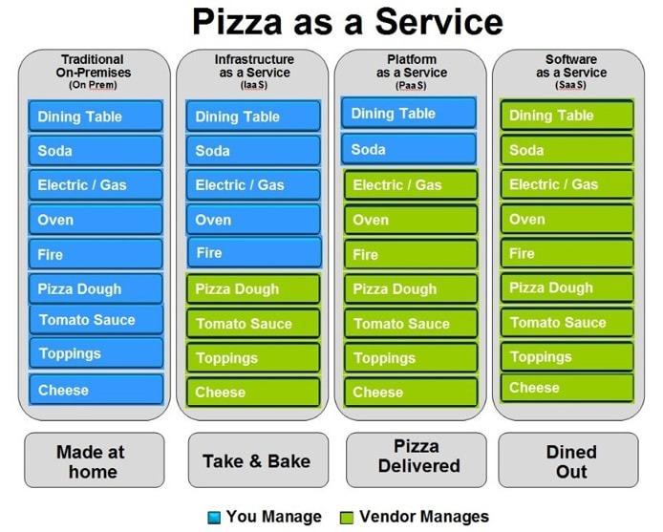

Slide 21
IaaS (Infrastructure as a Service), as the name suggests, provides you the computing infrastructure, physical or (quite often) virtual machines and other resources like virtual-machine disk image library, block and file-based storage, firewalls, load balancers, IP addresses, virtual local area networks etc.
Examples: Amazon EC2, Windows Azure, Rackspace, Google Compute Engine.
PaaS (Platform as a Service), as the name suggests, provides you computing platforms which typically includes operating system, programming language execution environment, database, web server etc.
Examples: AWS Elastic Beanstalk, Windows Azure, Heroku, Force.com, Google App Engine, Apache Stratos.
While in SaaS (Software as a Service) model you are provided with access to application software often referred to as "on-demand software". You don't have to worry about the installation, setup and running of the application. Service provider will do that for you. You just have to pay and use it through some client.
Examples: Google Apps, Microsoft Office 365.

Slide 22
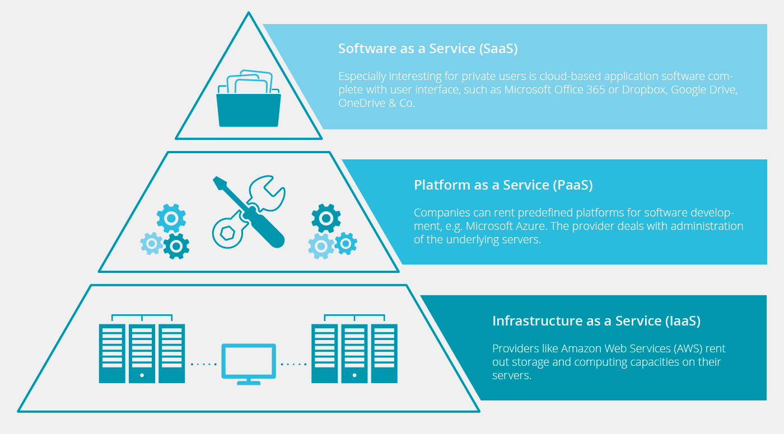

Slide 23
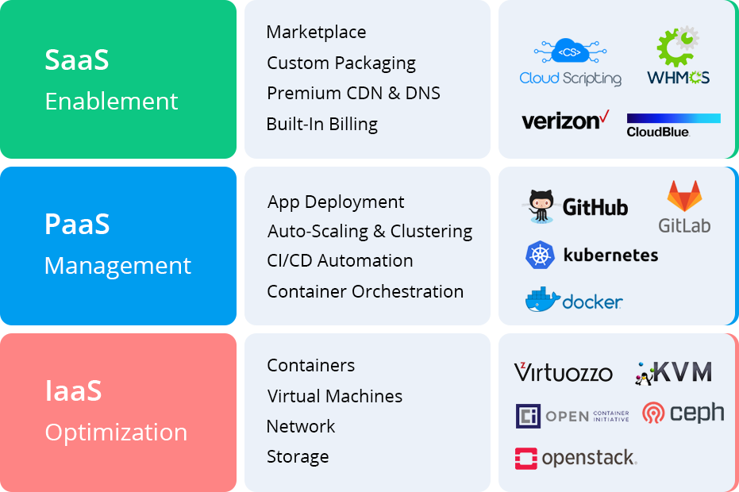

Slide 24
Q & A
Is Gmail IaaS or PaaS?
Is Netflix a SaaS?

Slide 25
2: Deployment model
Public
private
hybrid

Slide 26
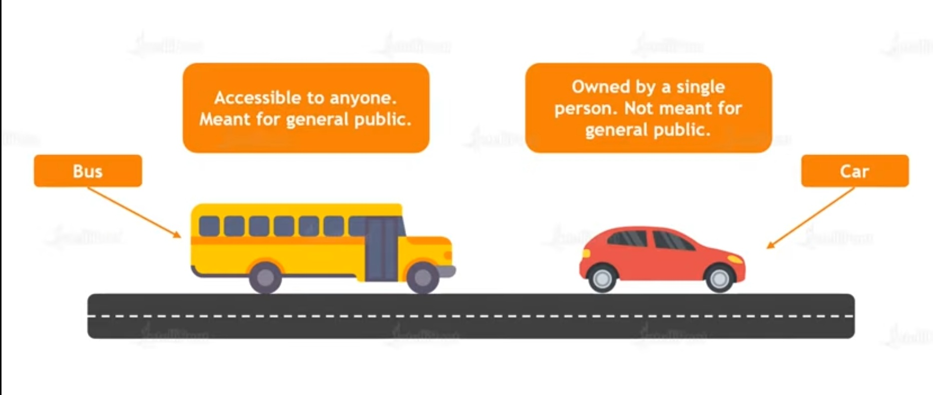
Public & Private

Slide 27
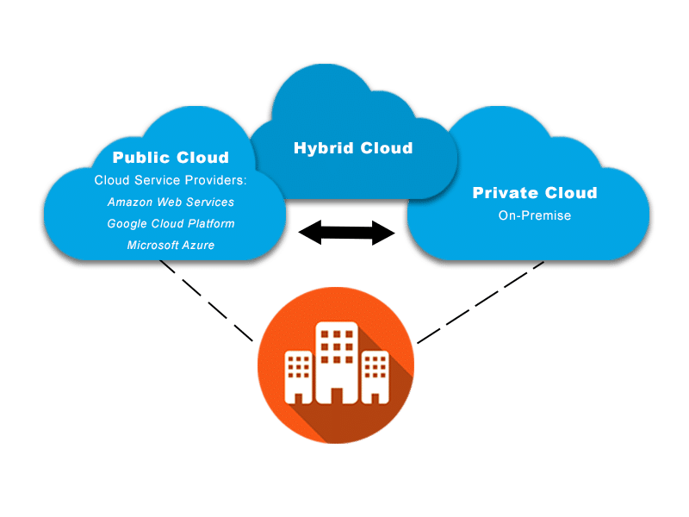
Public, Private,Hybrid

Slide 28

Advantages of Cloud Computing

Slide 29
Top Industrial Applications of Cloud Computing
1.Educational Institutions
2.Banking
3.Healthcare
4.Entertainment
5.Real Estate
6.Retail Industry
7.Automotive Industry

Slide 30


Slide 31
CapEx and OpEx
Capital expenditure:CapEx is defined as business expenses incurred in order to create long-term benefits in the future, such as purchasing fixed assets like a building or equipment.
Some examples of IT items that fall under this category would be whole systems and servers, printers and scanners, or air conditioners and generators.
You buy these items once and they benefit your business for many, many years.
Maintenance of such items is also considered CapEx, as it extends their lifetime and usefulness.

Slide 32
Operating expenditure
OpEx is your operating costs, the expenses to run day-to-day business, like services and consumable items that get used up and are paid for according to use.
This includes printer cartridges and paper, electricity, and even yearly services like website hosting or domain registrations.
These things are necessary for your business’s success but are not considered major long-term investments like CapEx items.

Slide 33
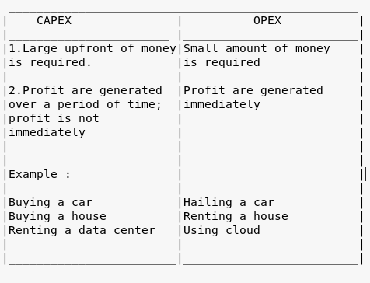
Capex vs opex

Slide 34
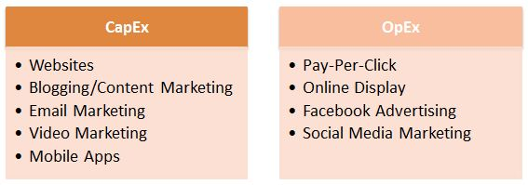
Examples

Slide 35
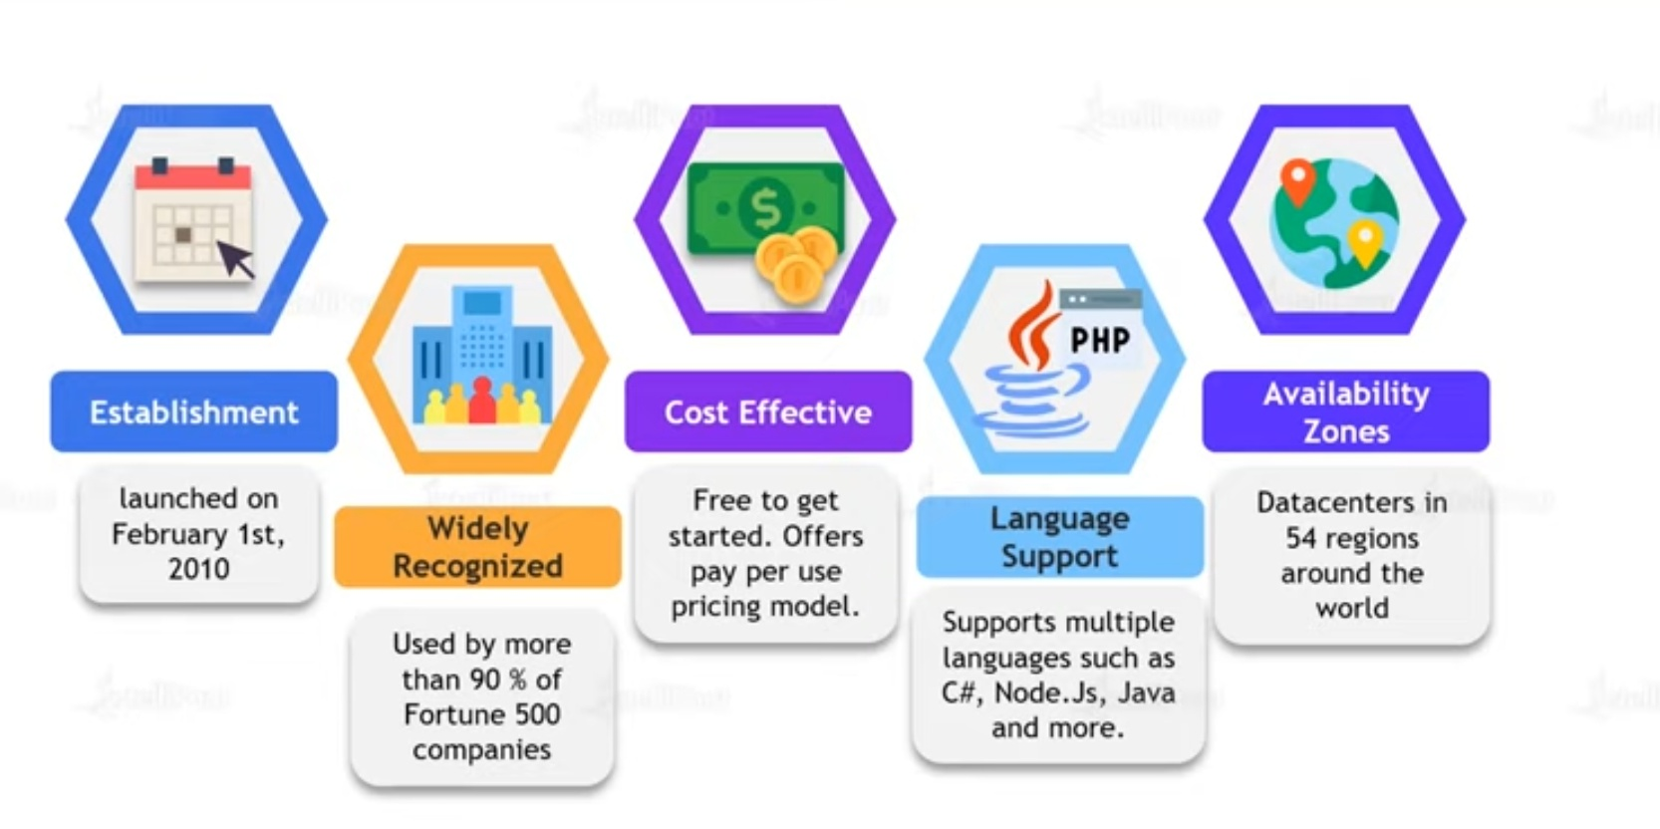
What is Microsoft azure

Slide 36

Advantages of MS Azure

Slide 37
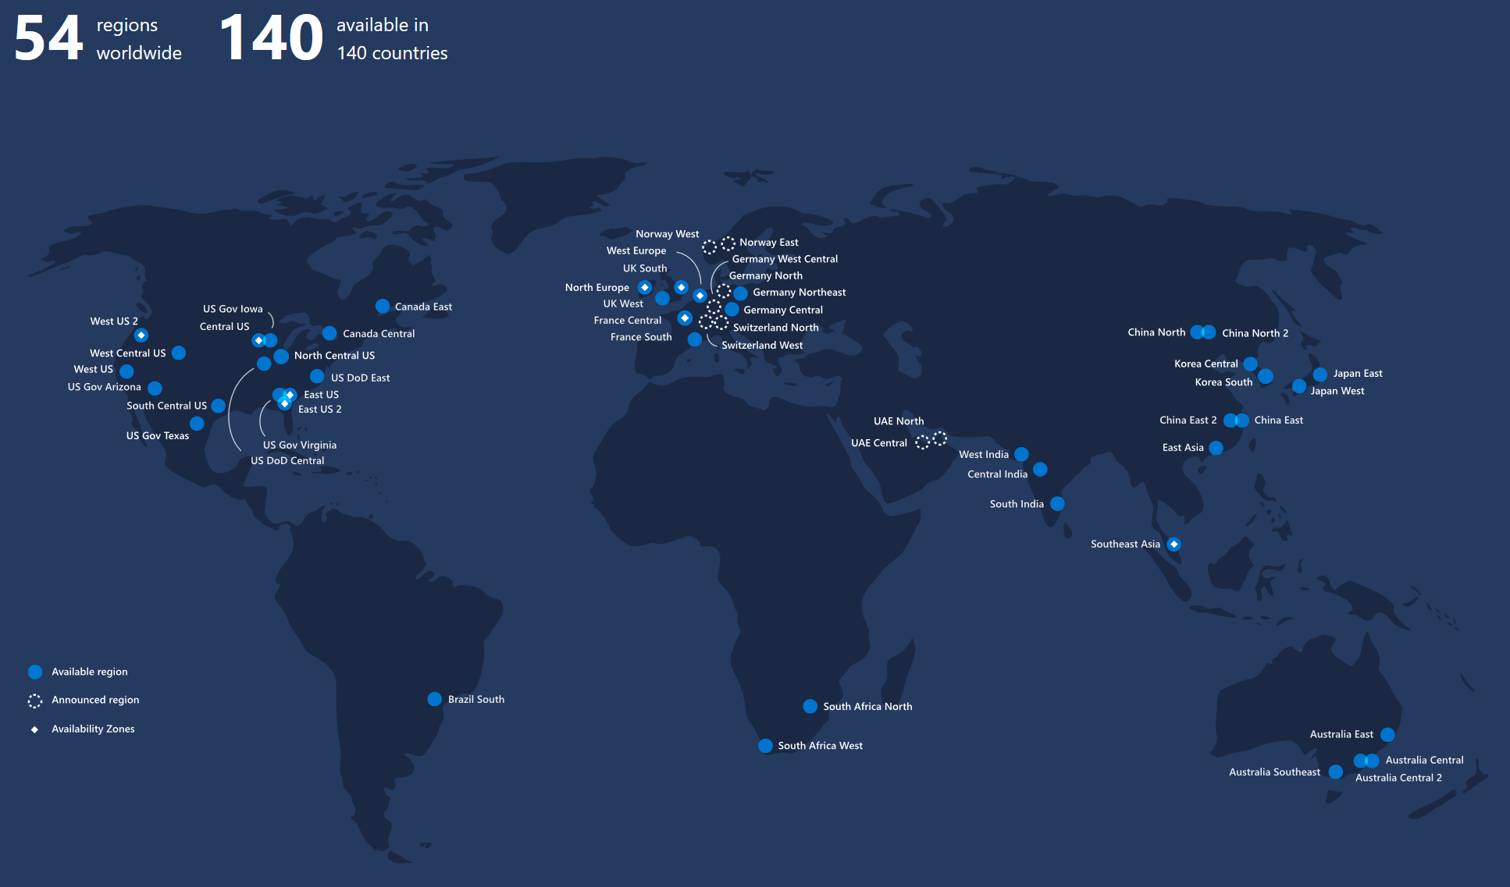
Azure Regions and Avalability zones

Slide 38
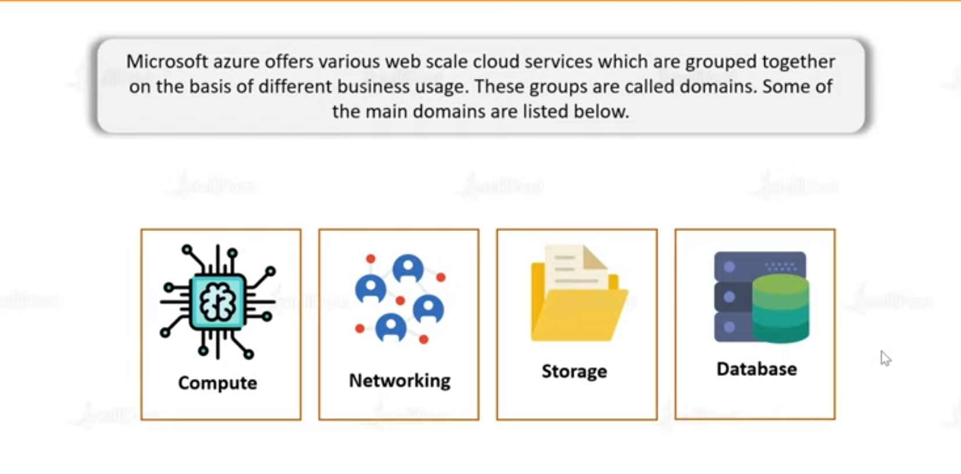
Microsoft Azure services

Slide 39
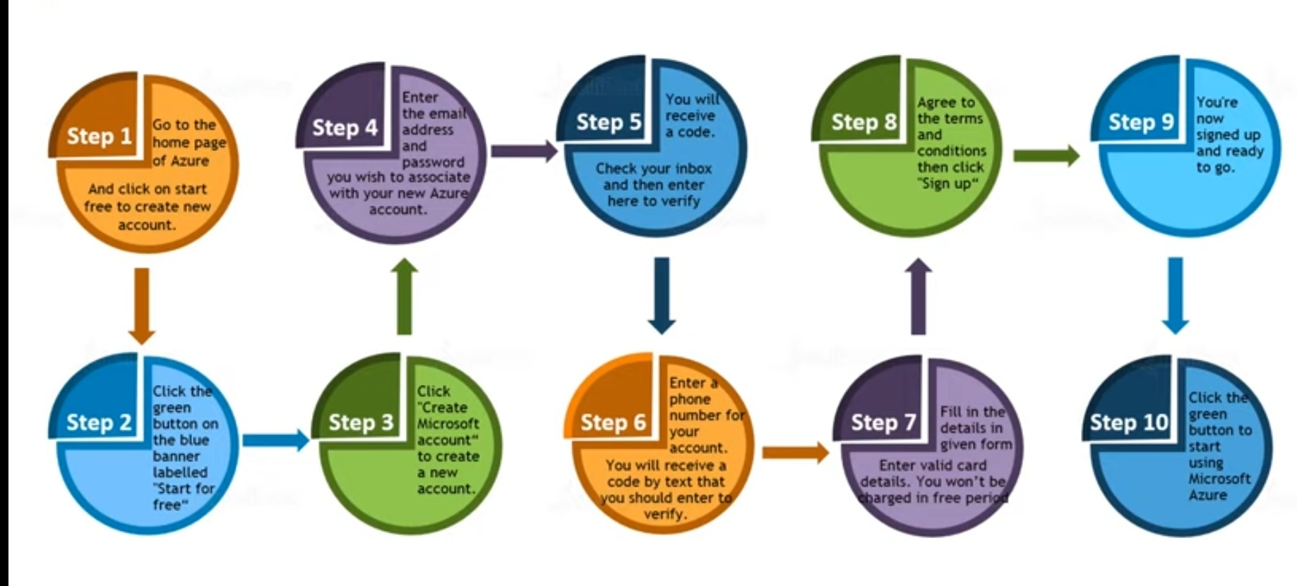
Creating Microsoft azure account

Slide 40
Create azure free account
Follow the steps
Go to browser and type Microsoft azure free account
or
Type http://portal.azure.com
Then fill the details for free subscription and login

Slide 41
Login and understanding the resources
Type your credentials to login to Microsoft azure
Then go to the portal
There are so many free services to use
Understand home page starting from menu
Followed by
Azure services
Navigate
Tools
See the portal menu in that there are so many options to learn lets see one by one but before that lets know something about azure portal in detail

Slide 42
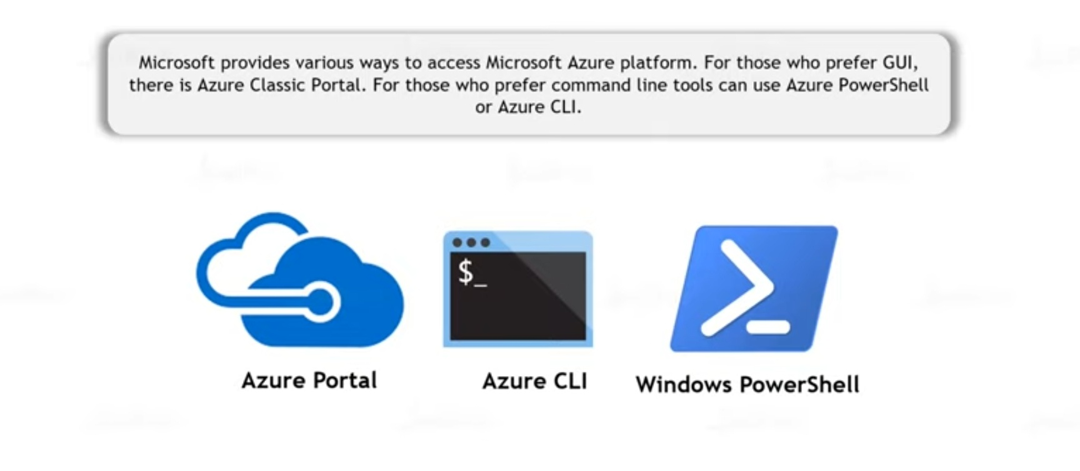
Ways of accessing Microsoft azure

Slide 43
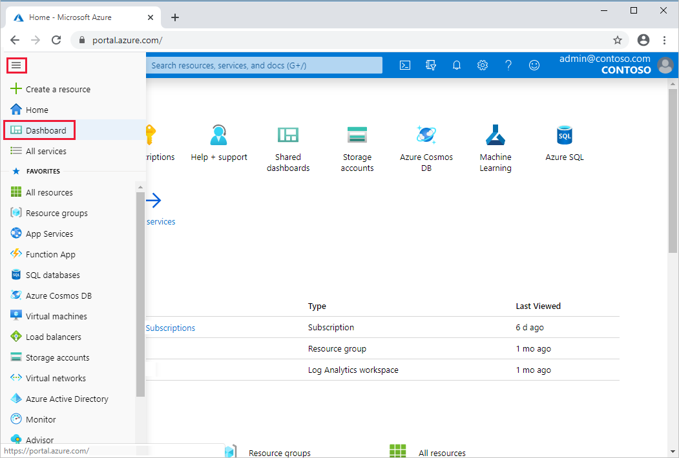
Azure portal

Slide 44
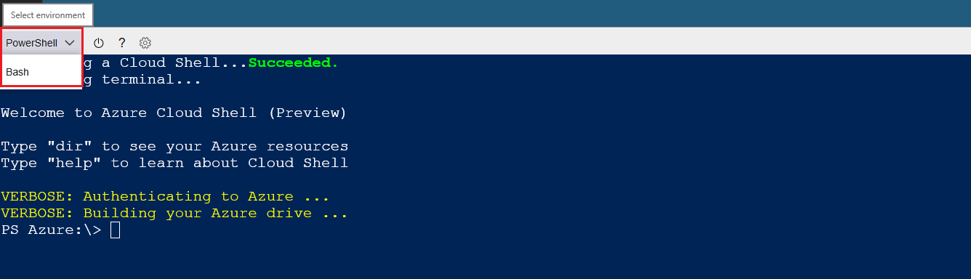
Azure powershell

Slide 45
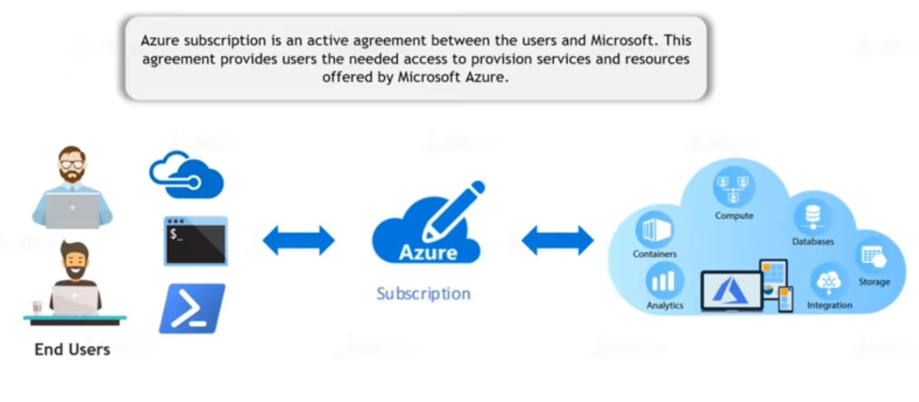
Azure subscriptions

Slide 46
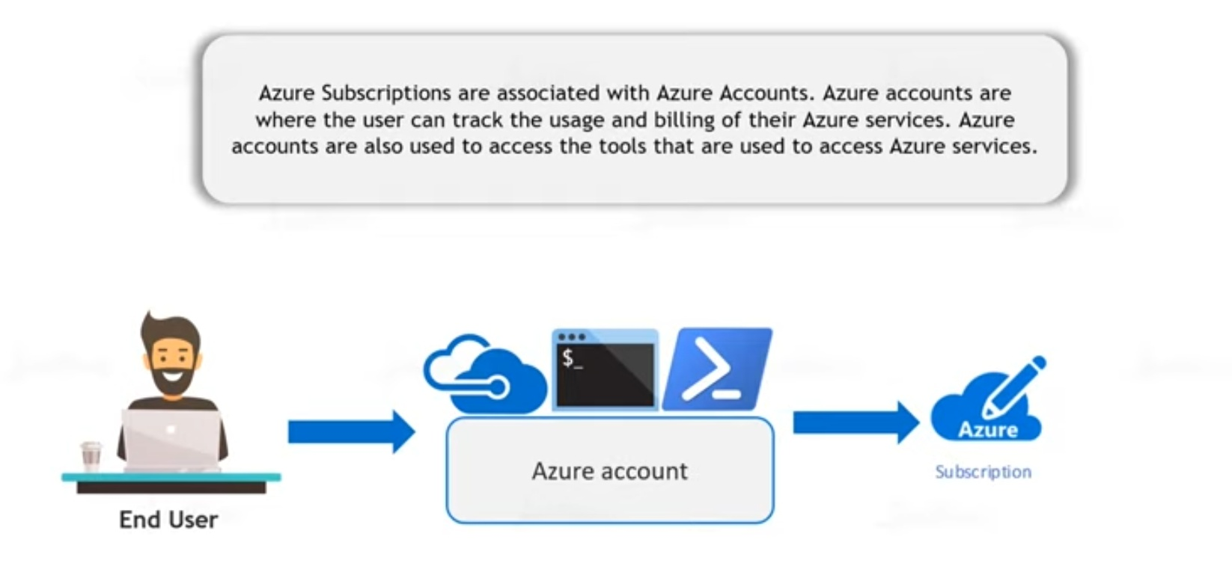

Slide 47
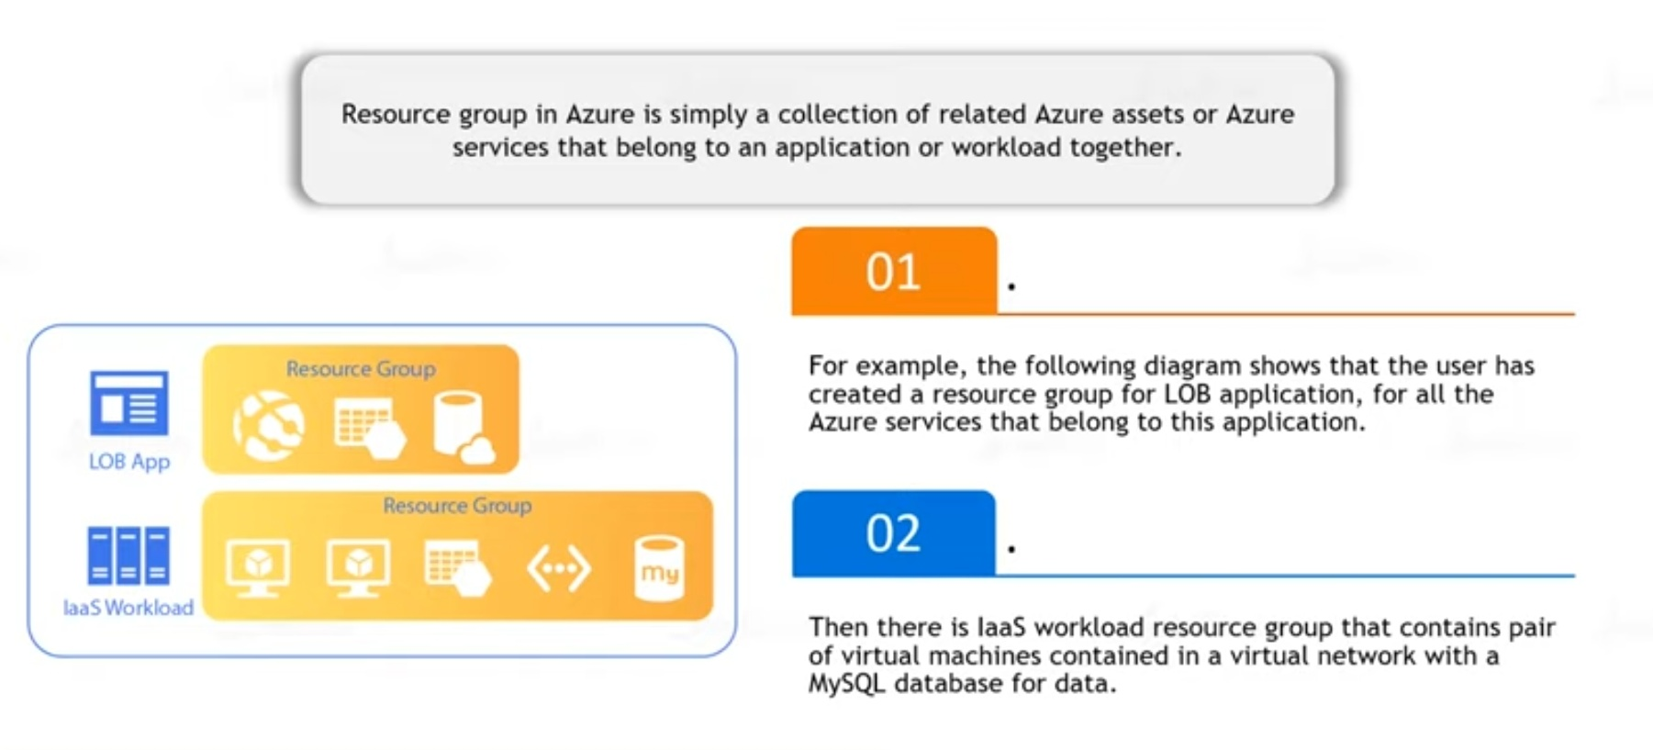
Azure Resource Groups

Slide 48
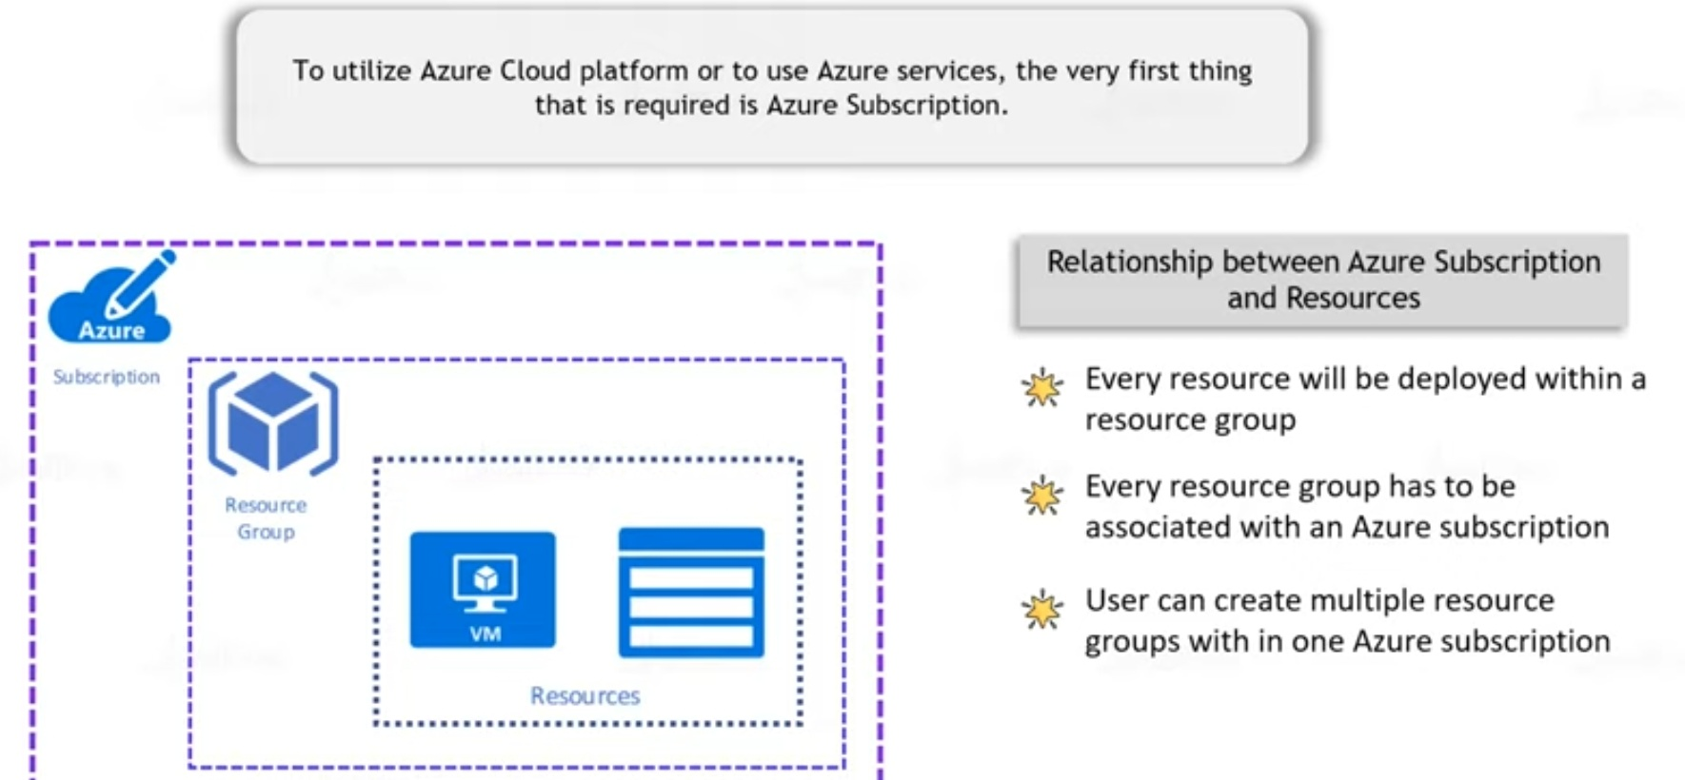
Azure Subscriptions and resources hierarchy

Slide 49
Resource group and resources
Resource groups: A resource group is a logical container into which Azure resources like web apps, databases, and storage accounts are deployed and managed.
Resources: Resources are instances of services that you create, like virtual machines, storage, or SQL databases.

Slide 50
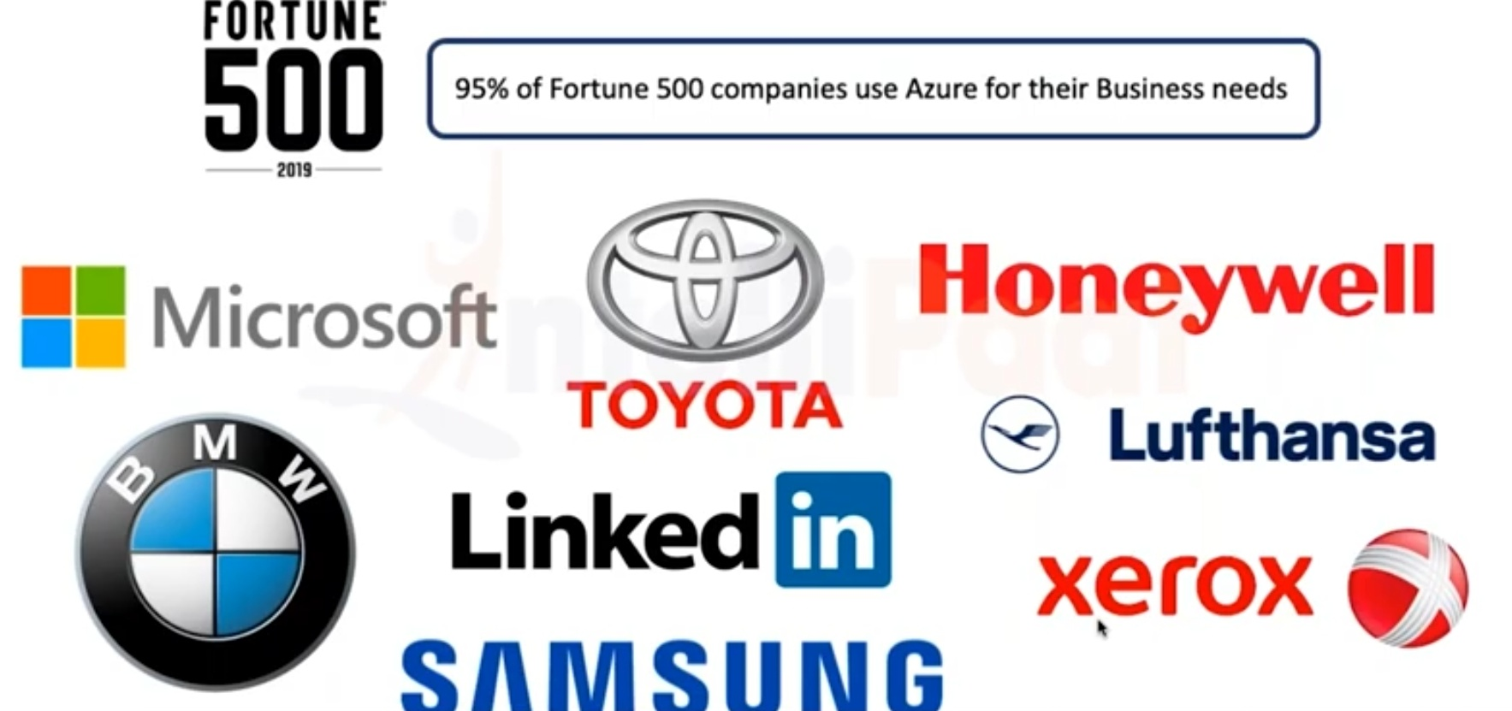
Companies who use Azure

Slide 51
DP-900 azure fundamental
Data
Types of data(structured,semi-structured,unstructured)
Data system(OLAP,OLTP)

Slide 52
This course is designed for students who want to attempt the Exam DP-900: Microsoft Azure Data Fundamentals
This course has contents for the Exam DP-900
The objectives covered in this course are
Describe core data concepts (15-20%)
Describe how to work with relational data on Azure (25-30%)
Describe how to work with non-relational data on Azure (25-30%)
Describe an analytics workload on Azure (25-30%)
The following key aspects are covered in this course
Working with SQL databases - Here we will see how to work with SQL databases using Microsoft SQL Server on an Azure virtual machine.
We will then explore the Azure SQL database service
We will look at non-relational data stores such as Azure Storage accounts and Azure Cosmos DB
We will look at Analytical services such as Azure Synapse
We will see how to use Azure Data Factory as an ETL tool
This course includes around 150 practice questions. These practice questions will help students be better prepared to take on the DP-900 exam.

Slide 53
Module objectives
Identify how data is defined and stored
Identify characteristics of relational and non-relational data
Describe and differentiate data workloads
Describe and differentiate batch and streaming data

Slide 54
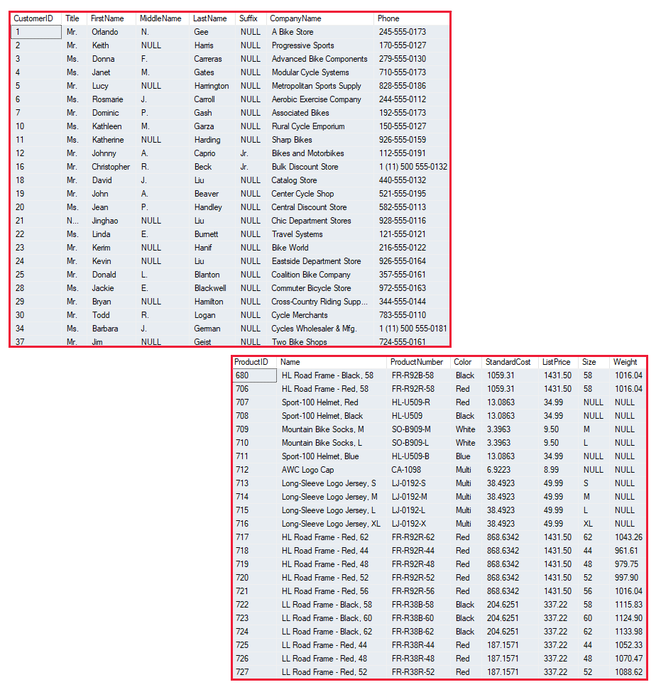

Slide 55
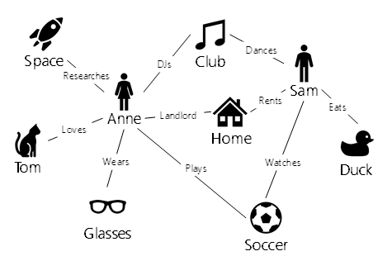

Slide 56


Slide 57
Answers
Gmail is one famous example of an SaaS mail provider.
First of all, to answer the question in the title: Yes, Netflix is a SaaS company that sells software to watch licensed videos on demand. It follows a subscription-based model whereby the user chooses a subscription plan and pays a fixed sum of money to Netflix monthly or annually. SaaS is not a new concept.

